Slide 1
[320] Welcome + First Lecture
[reproducibility]
Meenakshi (Meena) Syamkumar

Slide 2
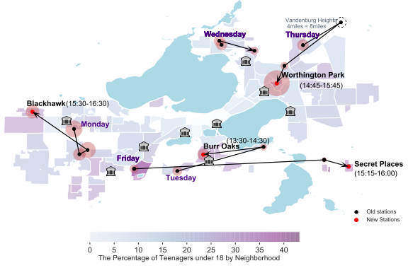
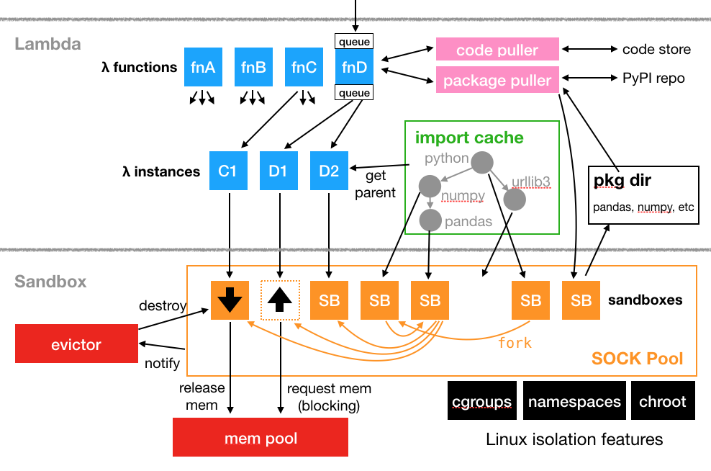
Introductions
Tyler Caraza-Harter
Long time Badger
Email: tharter@wisc.edu
Just call me “Tyler” (he/him)
Industry experience
Worked at Microsoft on SQL Server and Cloud
Other internships/collaborations: Qualcomm, Google, Facebook, Tintri
interests
civic "hacking"
OpenLambda
Plot by Zishan Bai & Dingyi Zhou (previous students)
More: https://wisc-ds-projects.github.io

Slide 3
Who are You?
Year in school?
1st year? 2nd? Junior/senior? Grad student?
Area of study
Natural science, social science, engineering, business, statistics, data science, other?
What CS courses have people taken before?
CS 220/301? CS 200? CS 300? CS 354?
Please fill this form (due today):
https://docs.google.com/forms/d/e/1FAIpQLSfz7K0cY2-VGCtxE4TQ-zkcbcWTtzyLZQXCrgLyp6EfwU2jDg/viewform?usp=sf_link.
Why?
Help me get to know you
Get participation credit
Group formation

Slide 4


Related courses
Upper Level Computer Science
Upper Level Data Science
CS 300
CS 354
CS 300
CS 320
STAT 340
L I S 461
CS 252
CS 200
CS 220
STAT 240
systems
(C)
programming
(Java)
data programming
(Python)
data modeling
(R)
ethics
P1 (Project 1) will help 300-to-320 students pickup Python.

Slide 5
Welcome to Data Programming II!
Builds on CS 301 220. https://stat.wisc.edu/undergraduate-data-science-studies/
CS 220
CS 320
getting results
getting reproducible results
writing correct code
writing efficient code
using objects
designing new types of objects
functions: f(obj)
methods: obj.f()
lists+dicts
graphs+trees
analyzing datasets
collecting+analyzing datasets
plots
animated visualizations
tabular analysis
simple machine learning
CS 301 content (for review): https://tyler.caraza-harter.com/cs301/fall19/schedule.html

Slide 6
Course Logistics

Slide 7
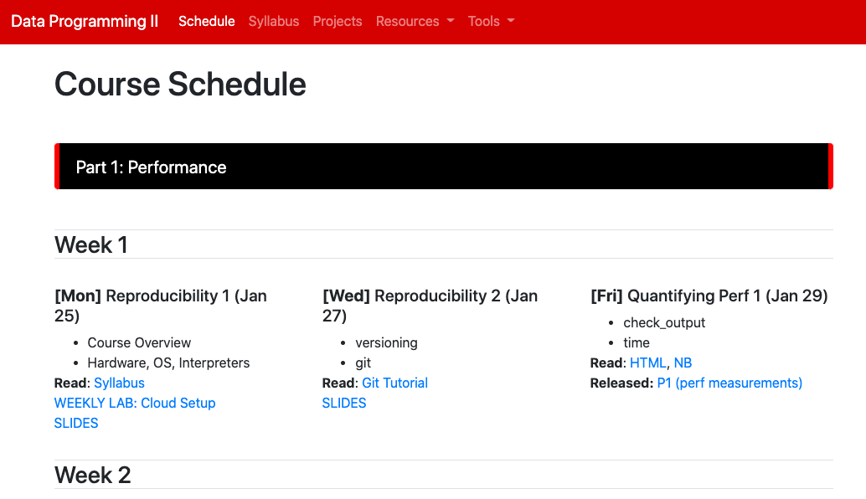
Course Website
It's here: https://tyler.caraza-harter.com/cs320/f22/schedule.html
read syllabus carefully
and checkout other content
I'll also use Canvas for four things:
general announcements
quizzes
online office hours
simple grade summaries (not feedback or exam answers)

Slide 8
Scheduled Activities
Lectures
3 times weekly
feel free to bring a laptop
will often be recorded+posted online (questions will be recorded -- feel free to save until after if you aren't comfortable being recorded)
might not post if bad in-person attendance or technical issues
Lab
Weekly on Mondays, bring a laptop
Work through lab exercises with group mates
320 staff will walk around to answer questions
Required for participation credit!
Answer TopHat question what at lab (https://app.tophat.com/e/594996) or fill "Lab Absence" each week for credit: https://tyler.caraza-harter.com/cs320/s22/surveys.html. We'll occasionally cross-check TopHat with paper sign-in.

Slide 9
Class organization: People
Teams
you'll be assigned to a team of 4-7 students
teams will last the whole semester
some types of collaboration with team members are allowed (not required) on graded work, such as projects+quizzes
most collaboration with non-team members in not allowed
Staff
Instructor
Teaching Assistants (grad students)
Mentors (undergrads)
we all provide office hours, and you can attend any that you prefer!

Slide 10
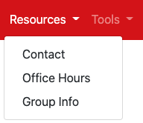
Class organization: People
Teams
you'll be assigned to a team of 4-7 students
teams will last the whole semester
some types of collaboration with team members are allowed (not required) on graded work, such as projects+quizzes
most collaboration with non-team members in not allowed
Staff
Instructor
Teaching Assistants
Mentors
head TA: in charge of projects
team TA: primary contact for team, same whole semester
grader TA: reviews projects (rotates weekly)
we all provide office hours, and you can attend any that you prefer!

Slide 11
Communication
Piazza
find link on site
don't post >5 lines of project-related code (considered cheating)
Forms
https://tyler.caraza-harter.com/cs320/f22/surveys.html
Who are you? Feedback Form. Thank you! Grading Issues.
Email
me: tharter@wisc.edu
TAs: https://canvas.wisc.edu/courses/322105/pages/contact-info

Slide 12
Course Etiquette
Meetings
office hours are drop-in (no need to reserve)
email me about individual meeting availability if needed
Email
let us know your NetID (if not from netid@wisc.edu)
don't start new email thread if topic is the same
CC team members when appropriate
unless urgent, please give me 48 hours to respond before following up (I'll try to be faster usually)
use your judgement about whether to email me or TA first (if one TA doesn't know something, ask me next before others)
if general question, consider using piazza instead if general interest

Slide 13
Graded Work: Exams/Quizzes
Ten Online Quizzes - 1% each
cumulative, no time limit
on Canvas, open book/notes
can take together AT SAME TIME with team members (no other human help allowed)
Midterms - 14% each
cumulative, individual, multi-choice, 40 minutes
one-page two-sided note sheet
in class
Final - 16%
cumulative, individual, multi-choice, 2 hours
one-page two-sided note sheet

Slide 14
Graded Work: Projects+Participation
7 Projects - 6% each
format: notebook, module, or program
part 1: you can optionally collaborate with team
part 2: must be individually (only help from 320 staff)
still a tester.py, but more depends on TA evaluation (more plots)
ask for specific feedback (giving constructive criticism is a priority in CS 320)
Participation - 4%
lab attendance
class surveys
etc.

Slide 15
Time Commitment
Observations
10-12 hours per project is typical
20% of students sometimes spend 20+ hours on some projects
students who were faster early on were less likely to complete the course
Typical Weekly Expectations
4 hours - lecture/lab
6 hours - project coding
2 hours - reading/quizzes/etc

Slide 16
Academic Misconduct
Read syllabus to make sure you know what is and isn't OK.
It's not obvious!
Since Fall 2019, I have made the following misconduct reports:
58 students for cheating on projects
2 past students for sharing solutions from past semesters
8 students for cheating on exams
1 student for faking participation
How we'll keep the class fair
run MOSS on submissions
randomize exam question order
Please talk to me if you're feeling overwhelmed with 320 or your semester in general!

Slide 17
Reading: same as 220/301 and some others...
I'll post links to other online articles and my own notes
Lectures don't assume any reading prior to class

Slide 18
Tips for 320 Success
Just show up!
Get 100% on participation, don't miss quizzes, submit group work
Use office hours
we're idle after a project release and swamped before a deadline
Do labs before projects
Take the lead on group collaboration
Learn debugging
Run the tester often
If you're struggling, reach out -- the sooner, the better

Slide 19
Any questions?

Slide 20
Today's Lecture:
Reproducibility

Slide 21
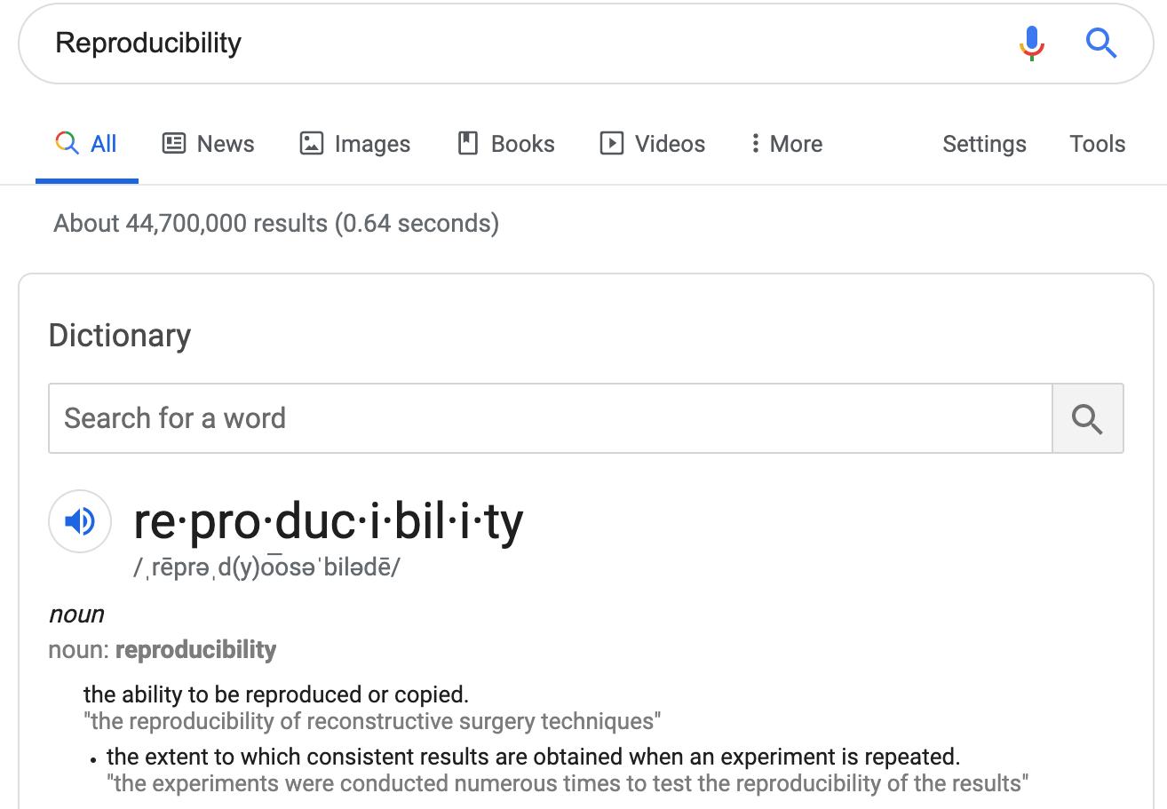
Discuss: how might we define "reproducibility" for a data scientist?

Slide 22
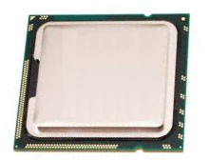
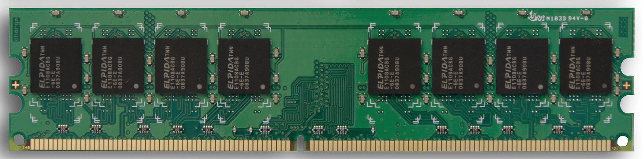
Big question: will my program run on someone else's computer? (not necessarily written in Python)
Things to match:
CPU
1
Hardware
2
Operating System
3
Dependencies
next lecture

Slide 23
Hardware: Mental Model of Process Memory
Imagine...
one huge list, per each running program process, called "address space"
every entry in the list is an integer between 0 and 255 (aka a "byte")
values (bytes)
0
0
0
0
0
0
0
0
0
0
0
0
0
0
0
0
...
0
1
2
3
4
5
6
7
8
9
10
11
12
13
14
15
indexes (aka "addresses")

Slide 24
How can we use one giant list to handle the following?
multiple lists
variables and other references
strings
code
data
0
0
0
0
0
0
0
0
0
0
0
0
0
0
0
0
...
0
1
2
3
4
5
6
7
8
9
10
11
12
13
14
15
Is this really all we have for state?

Slide 25
How can we use one giant list to handle the following?
multiple lists
variables and other references
strings
code
0
0
0
0
0
0
0
0
3
20
0
0
11
22
33
0
...
0
1
2
3
4
5
6
7
8
9
10
11
12
13
14
15
the [3,20] list starts at index address 8 in the giant list
the [11,22,33] list starts at address 12 in the giant list

Slide 26
How can we use one giant list to handle the following?
multiple lists
variables and other references
strings
code
0
0
0
0
0
0
0
0
3
20
0
0
11
22
33
0
...
0
1
2
3
4
5
6
7
8
9
10
11
12
13
14
15
# fast
L2.append(44)
implications for performance...

Slide 27
How can we use one giant list to handle the following?
multiple lists
variables and other references
strings
code
0
0
0
0
0
0
0
0
3
20
0
0
11
22
33
44
...
0
1
2
3
4
5
6
7
8
9
10
11
12
13
14
15
# fast
L2.append(44)
implications for performance...

Slide 28
How can we use one giant list to handle the following?
multiple lists
variables and other references
strings
code
0
0
0
0
0
0
0
0
3
20
0
0
11
22
33
44
...
0
1
2
3
4
5
6
7
8
9
10
11
12
13
14
15
# fast
L2.append(44)
# slow
L2.pop(0)
implications for performance...

Slide 29
How can we use one giant list to handle the following?
multiple lists
variables and other references
strings
code
0
0
0
0
0
0
0
0
3
20
0
0
22
33
44
...
0
1
2
3
4
5
6
7
8
9
10
11
12
13
14
15
# fast
L2.append(44)
# slow
L2.pop(0)
implications for performance...

Slide 30
How can we use one giant list to handle the following?
multiple lists
variables and other references
strings
code
0
0
0
0
0
0
0
0
3
20
0
0
22
33
44
0
...
0
1
2
3
4
5
6
7
8
9
10
11
12
13
14
15
# fast
L2.append(44)
# slow
L2.pop(0)
We'll think more rigorously about
performance in CS 320 (big-O notation)

Slide 31
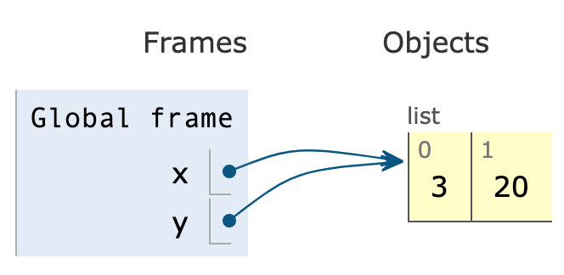
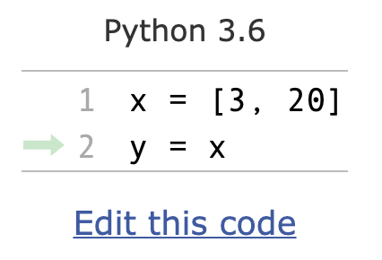
How can we use one giant list to handle the following?
multiple lists
variables and other references
strings
code
the x variable is at address 3
the y variable is at address 5
0
0
0
8
0
8
0
0
3
20
0
0
0
0
0
0
...
0
1
2
3
4
5
6
7
8
9
10
11
12
13
14
15
PythonTutor's visualization

Slide 32
How can we use one giant list to handle the following?
multiple lists
variables and other references
strings
code
discuss: how?
0
0
0
0
0
0
0
0
0
0
0
0
0
0
0
0
...
0
1
2
3
4
5
6
7
8
9
10
11
12
13
14
15
Is this really all we have for state?

Slide 33
How can we use one giant list to handle the following?
multiple lists
variables and other references
strings
code
???
0
0
0
0
0
0
0
0
0
0
0
0
0
67
65
66
...
0
1
2
3
4
5
6
7
8
9
10
11
12
13
14
15
code
65
66
67
68
...
letter
A
B
C
D
...
encoding:
f = open("file.txt", encoding="utf-8")

Slide 34
How can we use one giant list to handle the following?
multiple lists
variables and other references
strings
code
"CAB"
0
0
0
0
0
0
0
0
0
0
0
0
0
67
65
66
...
0
1
2
3
4
5
6
7
8
9
10
11
12
13
14
15
code
65
66
67
68
...
letter
A
B
C
D
...
encoding:
f = open("file.txt", encoding="utf-8")

Slide 35
How can we use one giant list to handle the following?
multiple lists
variables and other references
strings
code
while ????:
i += 2
# what line next?
operator
operand
0
0
0
0
0
0
0
0
...
...
5
2
33
8
0
0
...
0
1
2
3
4
5
6
7
8
9
10
11
12
13
14
15
code
5
8
33
...
operation
ADD
SUB
JUMP
...
Instruction Set
Notes:
f22: section 1

Slide 36
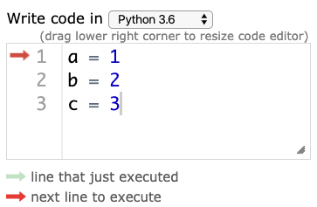

Hardware: Mental Model of CPU
CPUs interact with memory:
keep track of what instruction we're on
understand instruction codes
much more
CPU
0
0
0
0
0
0
0
0
...
...
5
2
33
8
0
0
...
0
1
2
3
4
5
6
7
8
9
10
11
12
13
14
15
code
5
8
33
...
operation
ADD
SUB
JUMP
...
Instruction Set

Slide 37
Hardware: Mental Model of CPU
CPUs interact with memory:
keep track of what instruction we're on
understand instruction codes
much more
CPU
add 2 to variable
0
0
0
0
0
0
0
0
...
...
5
2
33
8
0
0
...
0
1
2
3
4
5
6
7
8
9
10
11
12
13
14
15
code
5
8
33
...
operation
ADD
SUB
JUMP
...
Instruction Set

Slide 38
Hardware: Mental Model of CPU
CPUs interact with memory:
keep track of what instruction we're on
understand instruction codes
much more
CPU
go back to top of loop
0
0
0
0
0
0
0
0
...
...
5
2
33
8
0
0
...
0
1
2
3
4
5
6
7
8
9
10
11
12
13
14
15
code
5
8
33
...
operation
ADD
SUB
JUMP
...
Instruction Set

Slide 39
Hardware: Mental Model of CPU
CPUs interact with memory:
keep track of what instruction we're on
understand instruction codes
much more
CPU
0
0
0
0
0
0
0
0
...
...
5
2
33
8
0
0
...
0
1
2
3
4
5
6
7
8
9
10
11
12
13
14
15
code
5
8
33
...
operation
ADD
SUB
JUMP
...
Instruction Set

Slide 40
Hardware: Mental Model of CPU
discuss: what would happen if a CPU tried to execute an instruction for a different CPU?
0
0
0
0
0
0
0
0
...
...
5
2
33
8
0
0
...
0
1
2
3
4
5
6
7
8
9
10
11
12
13
14
15
code
5
8
33
...
operation
ADD
SUB
JUMP
...
code
5
8
33
...
operation
SUB
ADD
undefined
...
Instruction Set
for CPU X
Instruction Set
for CPU Y
Notes:
s22: lec 1+2 ended here

Slide 41
Hardware: Mental Model of CPU
a CPU can only run programs that use instructions it understands!
CPU Y
0
0
0
0
0
0
0
0
...
...
5
2
33
8
0
0
...
0
1
2
3
4
5
6
7
8
9
10
11
12
13
14
15
code
5
8
33
...
operation
ADD
SUB
JUMP
...
code
5
8
33
...
operation
SUB
ADD
undefined
...
Instruction Set
for CPU X
Instruction Set
for CPU Y

Slide 42
A Program and CPU need to "fit"
Program A
Program B
CPU X
CPU Y
Program B
Program A
CPU X
CPU Y

Slide 43
A Program and CPU need to "fit"
Program A
Program B
CPU X
CPU Y
why haven't we noticed this yet for our Python programs?

Slide 44
Interpreters
program.py
same
program.py
python code
python.exe (X)
python.exe (Y)
different
machine code
CPU X
CPU Y
different
Interpreters (such as python.exe) make it easier to run the same code on different machines
A compiler is another tool for running the same code on different CPUs

Slide 45
Interpreters
program.py
same
program.py
python code
python.exe (X)
different
python.exe (Y)
machine code
CPU X
different
CPU Y
Interpreters (such as python.exe) make it easier to run the same code on different machines
Discuss: if all CPUs had the instruction set,
would we still need a Python interpreter?

Slide 46
Big question: will my program run on someone else's computer? (not necessarily written in Python)
Things to match:
CPU
1
Hardware
2
Operating System
3
Dependencies
next lecture

Slide 47
Big question: will my program run on someone else's computer? (not necessarily written in Python)
Things to match:
1
many others...
Hardware
2
Operating System
3
Dependencies
next lecture
[this semester]

Slide 48
OS jobs: Allocate and Abstract Resources
[like CPU, hard drive, etc]
1
2
Allocation
Abstraction
Process B
f = open("file.txt")
data = f.read()
f.close()
waiting
...
Process Z
convenient
OS decides
Operating System
running
Process A
inconvenient
CPU X
only one process can run on CPU at a time (or a few things if the CPU has multiple "cores")
ignorant of
files/directories

Slide 49
Harder to reproduce on different OS...
bad.py
Python Interpreter
f = open("/data/file.txt")
...
Windows
CPU X
The Python interpreter mostly lets you
[Python Programmer] ignore the CPU you run on.
But you still need to work a bit to "fit" the code to the OS.

Slide 50
Harder to reproduce on different OS...
good.py
Python Interpreter
f = open("c:\data\file.txt")
...
Windows
CPU X
The Python interpreter mostly lets you
[Python Programmer] ignore the CPU you run on.
But you still need to work a bit to "fit" the code to the OS.

Slide 51
Harder to reproduce on different OS...
good.py
# solution 1:
f = open(os.path.join("data", "file.txt"))
...
Python Interpreter
Windows
# solution 2:
tell anybody reproducing your results to use the same OS!
CPU X
tradeoffs?
The Python interpreter mostly lets you
[Python Programmer] ignore the CPU you run on.
But you still need to work a bit to "fit" the code to the OS.

Slide 52

VMs (Virtual Machines)
popular virtual
machine software
Mac OS X
Programs
programs
programs
Linux OS
Windows OS
Virtual Machine
Virtual Machine
programs
Mac Operating System
Physical Machine
[CPU, memory, etc]
With the right virtual machines created and operating systems installed, you could run programs for Mac, Linux, and Windows -- at the same time without rebooting!

Slide 53

The Cloud
popular cloud providers
cloud providers let you rent VMs in the cloud on hourly basis (e.g., $15 / month)
Linux
here
VM
VM
VM
VM
remote connection
ssh session>
Windows, Mac, whatever
we'll use GCP virtual machines this semester
[setup in lab]
run in PowerShell/bash to access CS lab
ssh user@best-linux.cs.wisc.edu
https://docs.microsoft.com/en-us/windows-server/administration/openssh/openssh_install_firstuse

Slide 54
Lecture Recap: Reproducibility
Big question: will my program run on someone else's computer?
Things to match:
1
a program must fit the CPU;
python.exe will do this, so
program.py won't have to
Hardware
2
we'll use Ubuntu Linux on
virtual machines in the cloud
Operating System
3
Dependencies
next time: versioning

Slide 55
Recap of 15 new terms
reproducibility: others can run our analysis code and get same results
process: a running program
byte: integer between 0 and 255
address space: a big "list" of bytes, per process, for all state
address: index in the big list
encoding: pairing of letters characters with numeric codes
CPU: chip that executes instructions, tracks position in code
instruction set: pairing of CPU instructions/ops with numeric codes
operating system: software that allocates+abstracts resources
resource: time on CPU, space in memory, space on SSD, etc
allocation: the giving of a resource to a process
abstraction: hiding inconvenient details with something easier to use
virtual machine: "fake" machine running on real physical machine virtual machine: allows us to run additional operating systems
cloud: place where you can rent virtual machines and other services
ssh: secure shell -- tool that lets you remotely access another machine

